Slide 1
LOW POWER CRYPTO-CHIP FOR IOT APPLICATIONS
Secure IoT demands ultra-low power cryptography solutions. The PRESENT algorithm offers a lightweight, hardware-friendly block cipher perfect for resource-constrained devices.
PRESENTED BY:
ARPITHA SUSHE A

Slide 2


Low power crypto chips are specially designed to perform encryption and decryption efficiently with very low energy usage.
These chips use lightweight cryptographic algorithms that are optimized for speed and energy efficiency.
They enable secure communication in IoT devices across various fields like smart homes, healthcare, agriculture, and industrial systems.
Such chips help achieve real-time security while maintaining long battery life in IoT nodes.

Slide 3


PROJECT OBJECTIVES
Design Implementation
Create hardware-optimized PRESENT cipher implementation for IoT applications.
Power Optimization
Achieve sub-10μW power consumption during active encryption operations
Performance Testing
Measure throughput, latency, and energy consumption on target hardware
Security Validation
Verify resistance against side-channel and cryptanalytic attacks.

Slide 4
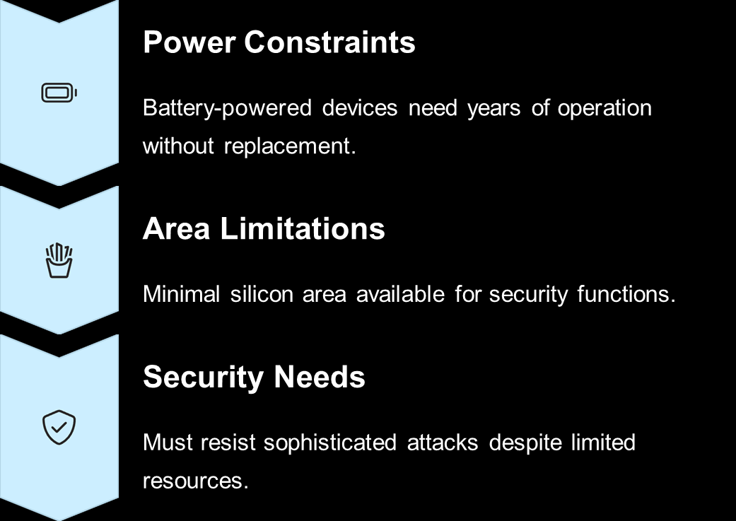
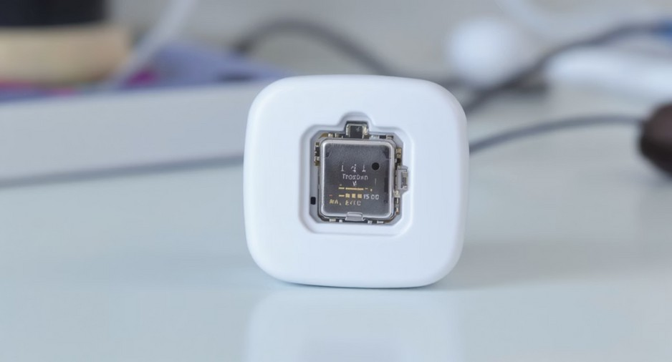
IoT devices face unique challenges that conventional cryptographic solutions fail to address.

Slide 5



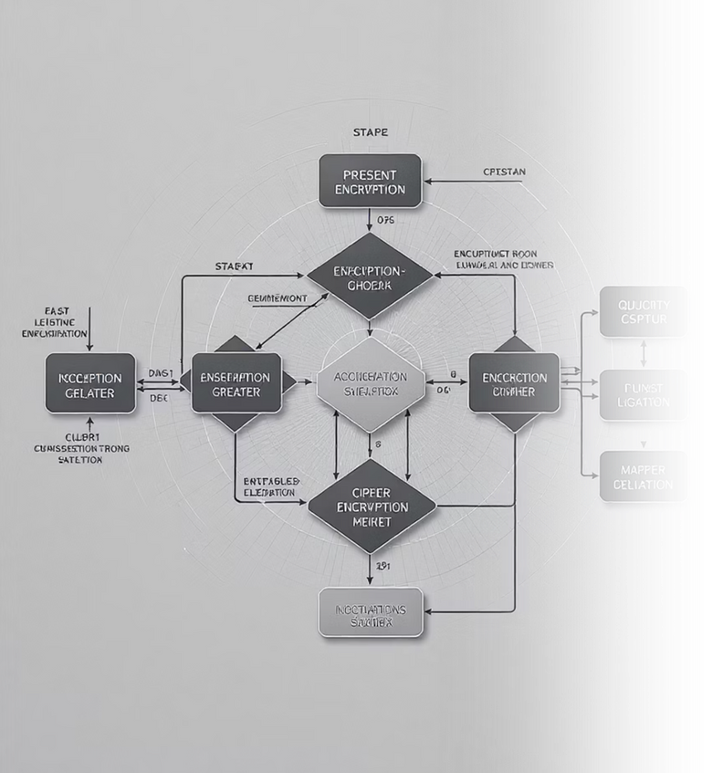



Lightweight Design
64-bit block size with 80/128-bit key options. Requires just 1570 gate equivalents
Energy Efficiency
Optimized for hardware implementation with minimal power consumption per operation
Security Strength
31 rounds provide adequate security margin against known attacks for IoT applications.

Slide 6

Overview: PRESENT Algorithm
Key Features Algorithm Structure
Lightweight block cipher with ISO/IEC standardization
Key Addition
64-bit block size with 80/128-bit key options
XOR operation with round key
Optimized for hardware-constrained environments
31 rounds of substitution-permutation network
S-Box Layer
Non-linear substitution with 4- bit S-boxes
Permutation Layer
Bit permutation for diffusion

Slide 7


Challenges in IoT Security
Resource Limitations
Traditional crypto demands too much power and memory.
Upgrade Difficulties
Long-lived devices need cryptosystem refreshes.
Quantum Threats
Emerging quantum computing poses additional security risks.

Slide 8
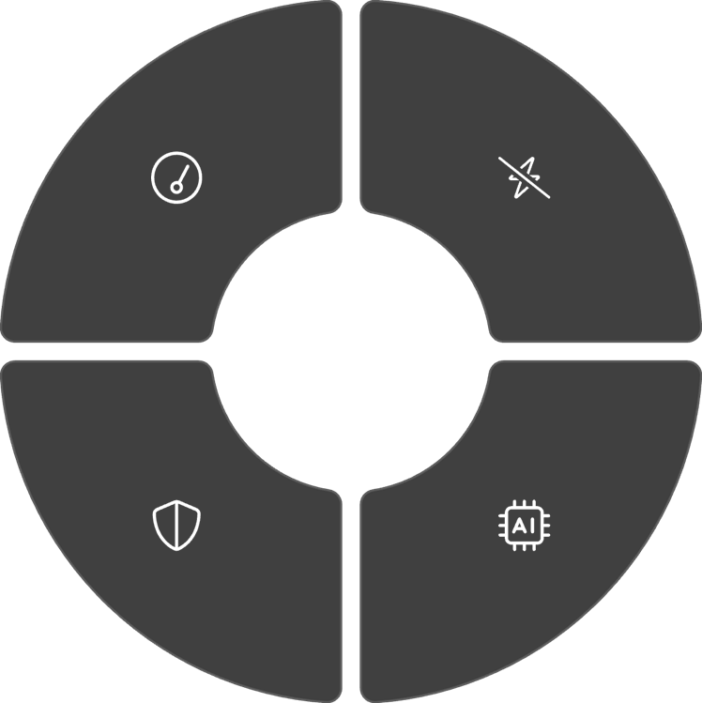
Performance & Results: Measured Metrics
Energy Efficiency
Throughput
50-200 pJ per bit on measured hardware chips
Up to 200 Mbps @ 100 MHz on FPGA implementation
Area Efficiency
Security Level
Resistant to differential cryptanalysis attacks up to 16 rounds
1.5K-2.5K gate equivalents depending on optimization

Slide 9
Sample PRESENT Algorithm Implementation (Verilog)
module present_round ( input [63:0] state_in,
input [79:0] key,
output [63:0] state_out
);
wire [63:0] after_keyadd;
wire [63:0] after_sbox;
// Key addition
assign after_keyadd = state_in ^ key[79:16];
// S-box layer present_sbox sbox_inst (
.data_in(after_keyadd),
.data_out(after_sbox)
);
// Permutation layer present_perm perm_inst (
.data_in(after_sbox),
.data_out(state_out)
);
endmodule
This hardware implementation illustrates the core PRESENT algorithm components

Slide 10


Conclusion & Future
PRESENT algorithm offers a proven solution for low-power, secure IoT hardware implementations.
Hardware crypto-chips significantly extend battery life while simplifying software integration.
Future Directions
Post-quantum cryptography adaptations for IoT security
Emerging Technologies
Reconfigurable and AI-accelerated cryptographic workflows

Slide 11

THANK YOU

